Slide 1
Digital Image Processing
Di2code (Diagram to code)

Slide 2
Description of project
As software engineers, we use Unified Modeling Language (UML) almost
constantly.
Class diagram in (UML) is a type of static structure diagram that describes
the structure of a system by showing the system's classes, their attributes,
operations (or methods), and the relationships among objects.
We generally draw this diagram by hand. Then spend quite some time to
convert it to computer-made diagrams using any tool and then spend time
to convert that specific diagram into a code using any specified
programming language.
This is where our project comes to rescue, Our Goal is to help software
engineers save time and effort by doing all the hard work for them. All by
capturing a photo of their hand-written class diagram , we will be able to
draw it and convert it to code.

Slide 3
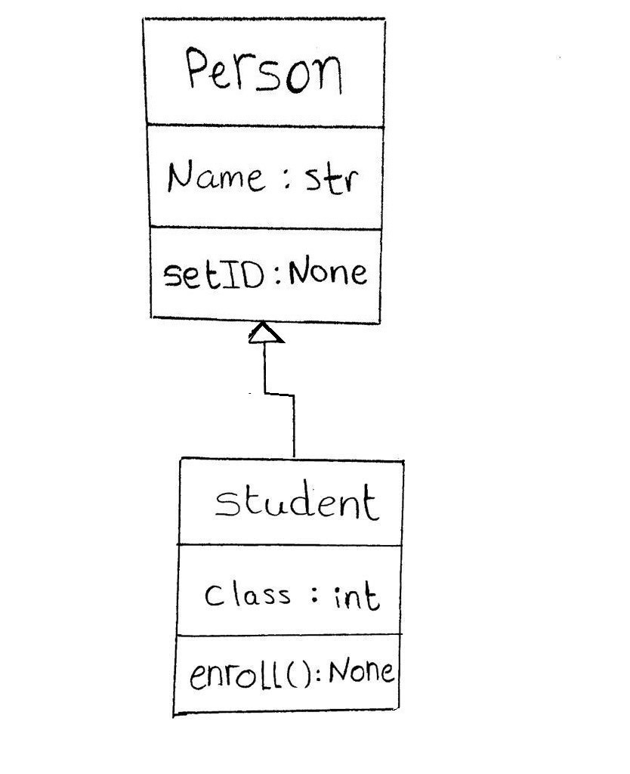
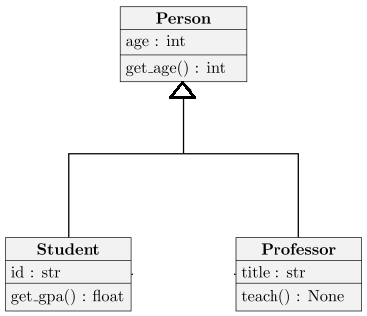
Input Image

Slide 4
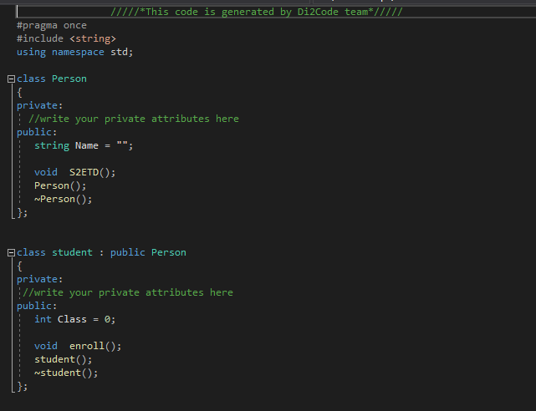
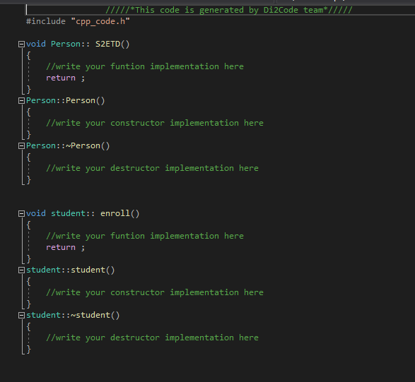
C++ Code Generation

Slide 5
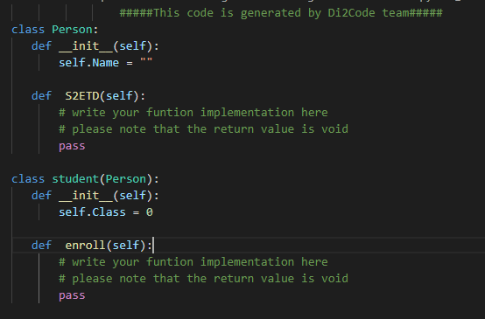
Python Code Generation

Slide 6
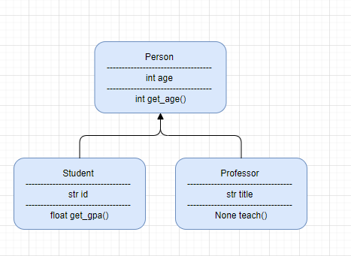
Output Image on drow.io tool

Slide 7
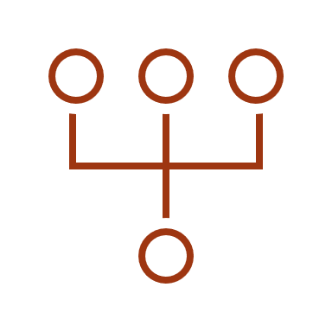
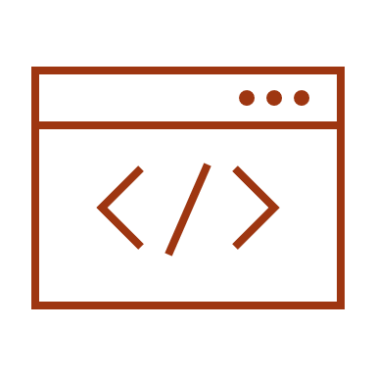

The Main Modules of project
Core
Shape Detection & OCR
Web Application
Code Generation
Diagram Generation

Slide 8



Adopted language used in the project
Python is the high language used in project with different libraries (OpenCv, tesseract).
User Interface is a web application designed using Flask.

Slide 9
DEMO

Slide 10
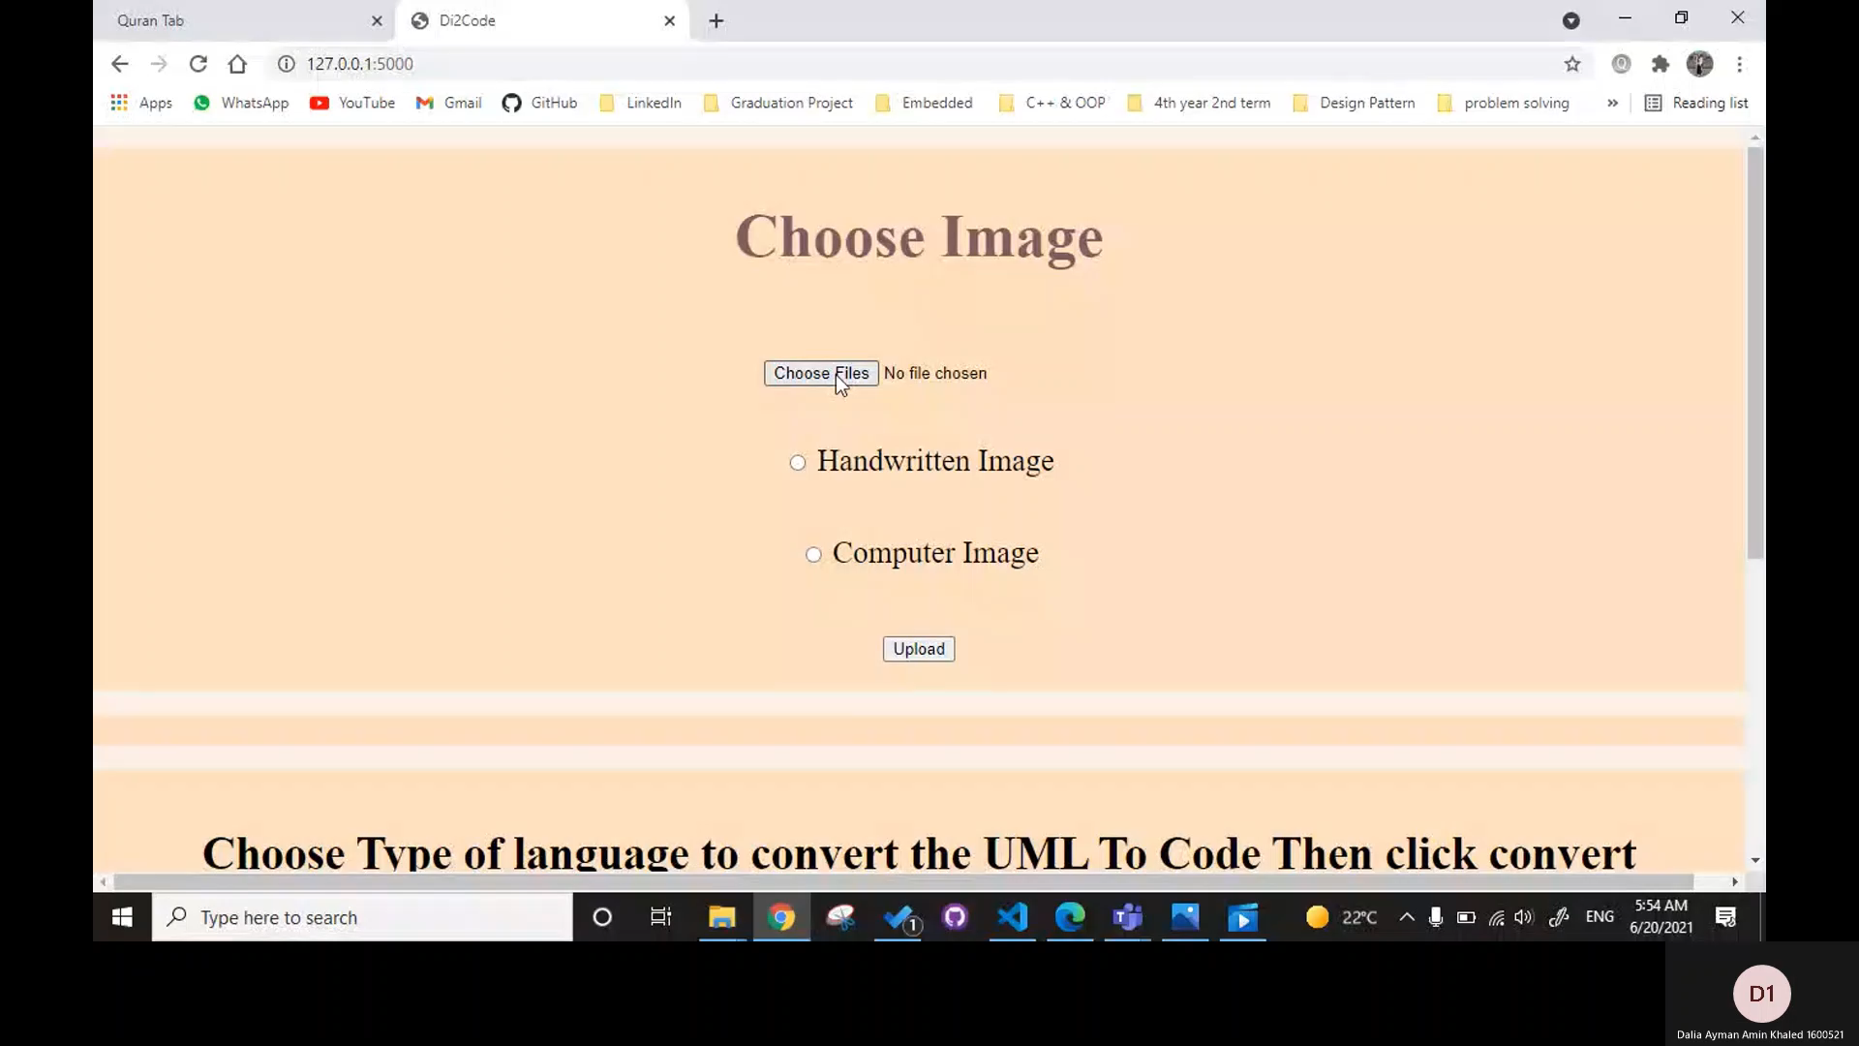
Demo

Slide 11
What is Next ??
Generalization
- Support more relations(aggregation, composite)
- Ability to have multiple parents
OCR
Work on accuracy and efficiency of character detection
Languages
Support different languages for code generation (java , c#)
UI
Improve User interface

Slide 12
Thank You!😊

